Slide 1

The Single-Sample t Test
Chapter 9

Slide 2
t distributions
Sometimes, we do not have the population standard deviation.
(that’s actually really common).
So what can we do?

Slide 3
t distributions
The t distribution is used when we do not know the population information.
So we use the sample to estimate the population information.
Because we are using the sample, the t distribution changes based on that sample.

Slide 4
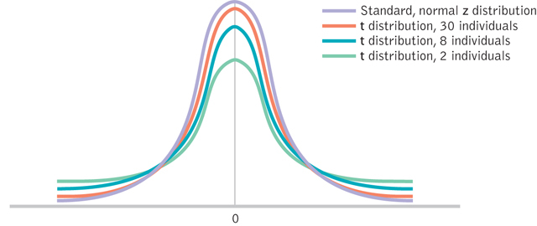
t distributions

Slide 5
The t Statistic
When sample size increases, s (the spread of t) approaches σ and t and z become more equal
The t distributions
Distributions of differences between means

Slide 6
Wider and Flatter t Distributions

Slide 7
Check Your Learning
When would you use a z test?
When would you use a t test?

Slide 8
Types of t
Single sample t
One sample (group of people), population mean to compare against
Dependent sample t
One sample tested twice to compare those two scores
Independent sample t
Two samples to compare those two groups

Slide 9
t distributions
Sample Standard Deviation
Population Standard Deviation
What we did before…
Biased estimate
New formula…
Unbiased estimate
Based on some error

Slide 10
Calculating the Estimated Population SD
Step 1: Calculate the sample mean
Step 2: Use the sample mean in the corrected standard deviation formula

Slide 11
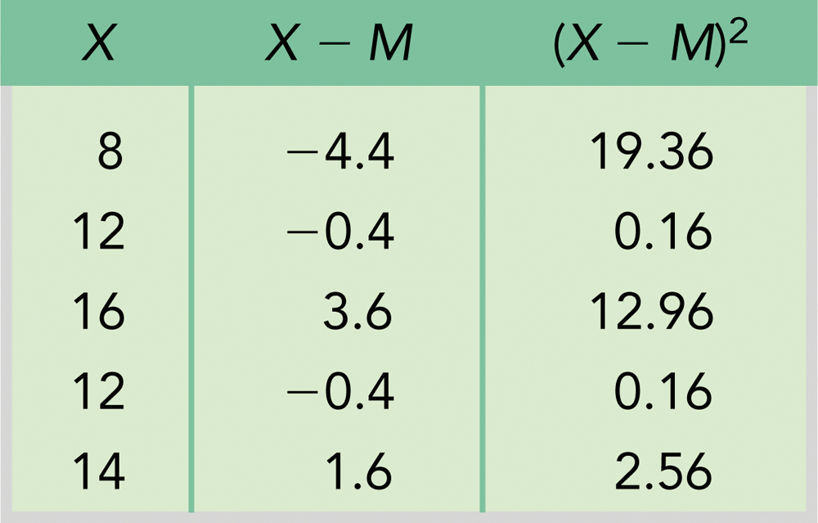
Steps to calculating s:
= 8.8 = 2.97

Slide 12
SPSS Steps
Remember you can get the SD from SPSS!
(chapter 4)

Slide 13
Calculating Standard Error for the t Statistic
Using the standard error
The t statistic

Slide 14
Steps to calculating t statistic using standard error:
From previous example:
Assume population mean is 11:
= 2.97

Slide 15
t distributions
SPSS will also calculate these values for you!
There are several types of t tests (covered in the next chapter).
Let’s go over single sample t.

Slide 16
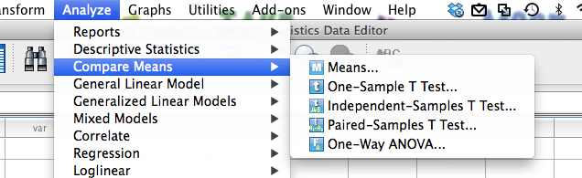
SPSS
Analyze > compare means > one-sample t

Slide 17
SPSS
Move variable over to the right.
Be sure to change the test value.

Slide 18
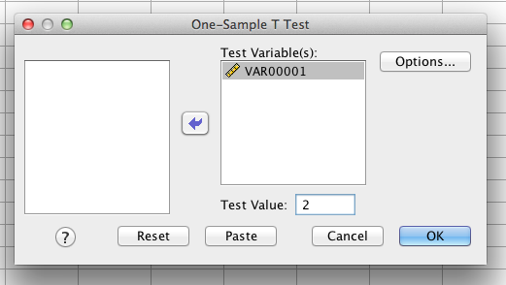
SPSS

Slide 19
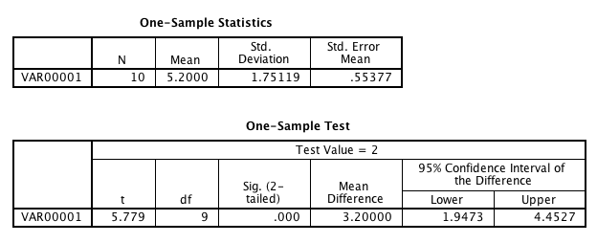
SPSS

Slide 20
Hypothesis Tests: The Single Sample t Test
The single sample t test
When we know the population mean, but not the standard deviation
Degrees of freedom
df = N - 1 where N is sample size

Slide 21
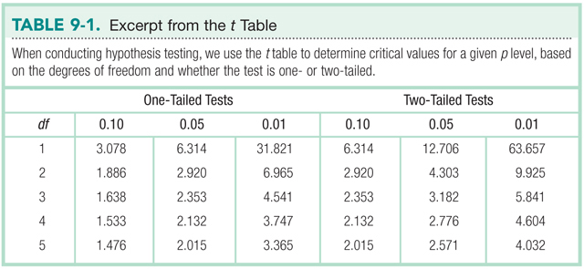
Stop and think. Which is more conservative: one-tailed or two-tailed tests? Why?

Slide 22
The t test
The six steps of hypothesis testing
1. Identify population, distributions, assumptions
2. State the hypotheses
3. Characteristics of the comparison distribution
4. Identify critical values
df =N-1
5. Calculate
6. Decide

Slide 23
Calculating Confidence Intervals
Draw a picture of the distribution
Indicate the bounds
Look up the t statistic
Convert the t value into a raw mean

Slide 24
Example Confidence Interval
STEP 1: Draw a picture of a t distribution that includes the confidence interval
STEP 2: Indicate the bounds of the confidence interval on the drawing

Slide 25
Confidence Interval Continued
STEP 3: Look up the t statistics that fall at each line marking the middle 95%

Slide 26
Confidence Interval Example
STEP 4: Convert the t statistics back into raw means.

Slide 27
Confidence Interval Completed
STEP 5: Check that the confidence interval makes sense
The sample mean should fall exactly in the middle of the two ends of the interval:
4.71-7.8 = -3.09 and 10.89 - 7.8 = 3.09
The confidence interval ranges from 3.09 below the sample mean to 3.09 above the sample mean.

Slide 28
Interpretation of Confidence Interval
If we were to sample five students from the same population over and over, the 95% confidence interval would include the population mean 95% of the time.

Slide 29
Calculating Effect size
For the counseling center data:

